Slide 1
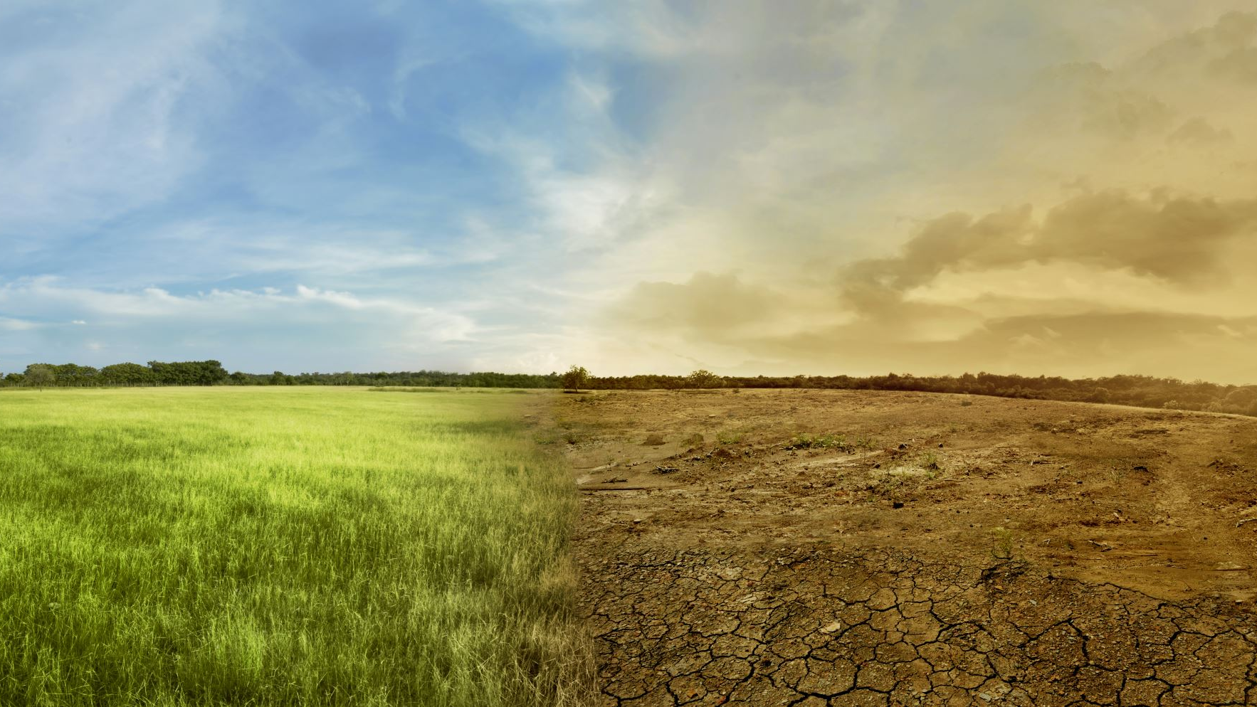

FIELD REPORT
ON
“A GEOGRAPHICAL CASE STUDY ON PHYSICAL & SOCIO ECONOMIC PROBLEM DUE TO COASTAL ENVIRONMENT OF SAFARCHATA VILLAGE UNDER KHEJURI-II BLOCK IN PURBA MEDINIPUR DISTRICT (W.B)”
SEMESTER-5, PAPER-CC-11P, SESSION-2022-23
DEPARTMENT OF GEOGRAPHY
MUGBERIA GANGADHAR MAHAVIDYALAYA

Slide 2


NECESSITY OF FIELD SURVEY IN GEOGRAPHY
Surveying or research work is the art of investigation from different aspects. In this modern world every society is faced by serious social problems and economic problem also systematic solution is needed to solve these problems.
In other words the field study should be systematic and world through different knowledge of different aspects. It is a process which should be scientific method should be taken to solve the problems. It is essential to built-up and develops our concepts for field–work. Field study also research provides work and investigation which is necessary to solve the problems. The study on socio economic aspect is essential to the research work to complete comprehensive to be about the region socio economic survey should be under systematic method which may help to get idea of new facts.

Slide 3


SELECTION OF THE STUDY AREA
We select our study area Safarchata village under Khejuri-II Block which is near about 38 km from our college.
Safarchata village being situated a coastal region becomes strategically important from environmental as well as social and economic point of view.
Our study area are selected from this point of view-
The area, though a rural village, but is much exposed to the new changing lifestyle.
The region has a considerable growth of fishery that affects the social and economic status of the villages.
The region also portrays a huge effect of physical environment on the economic life of the people.
The region has both agricultural patterns of occupation and fishery which makes the region an interesting study not only in spatial context, but also in temporal context.
The economy of the region thus has changed considerably which makes it an important and interesting study area.
In present the area effect by different coastal hazard, therefore people are faced huge problem of their lifestyle. We want to know what type of problem faced by people as well as coastal environment.

Slide 4
AIM AND OBJECTIVES OF THE FIELD STUDY
The aim and objectives of the present study area are as follows-
To study how the underlying geology reflects the land form pattern of the study area.
To understand the elements of the physical environment of the study area in regard to the physiographic, drainage, climate and soil.
To find out the nature of plot to plot land-use and any seasonal changing pattern of the study area.
To examine the relation between topography and land-use, climatic and agriculture, as well as soil pH and land-use, sex ratio and marital status with age sex structure and also health status.
To analysis the occupational structure of the people and the temporal changes if any.
To estimate the pattern of literacy among the people of the study area.
To analysis the housing condition and energy consumption and disposal of waste materials.
To understand and explain the condition of the economy with returns to agriculture, industry, trade and commerce.
To obtain on idea and to find out the physical, social and economic problems due to coastal environment as well as present coastal hazards.
To suggest remedial measures for rising physical, social and economic problem by effect of coastal hazard.
Thus the field report might help in the planning process of the area under study.

Slide 5
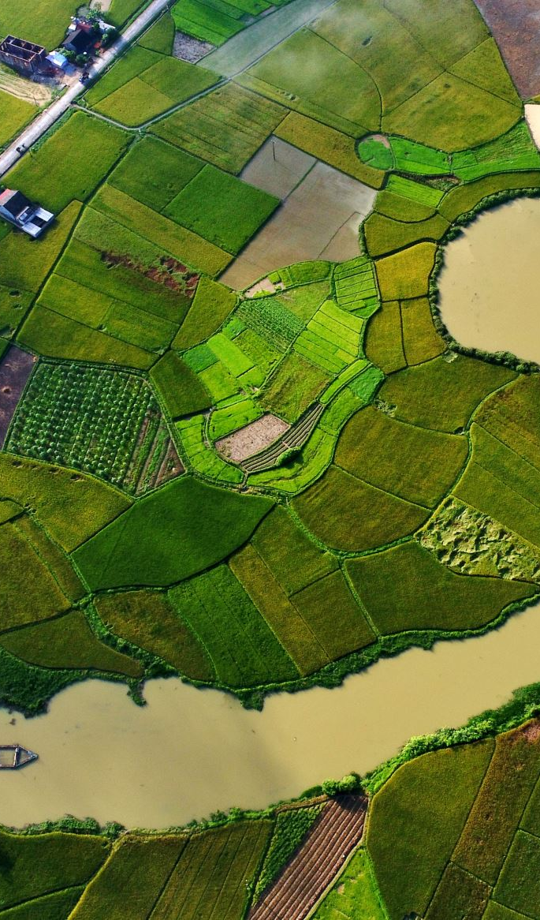
PROCESS OF FIELD SURVEY METHODOLOGY
Our field survey at Safarchata village of under Khejuri –II in Purba Medinipur district has been conducted through some sequential and systematic methods. This method may be divided in three categories which are given below-
a. PRE FIELD-STAGE:
In this stage some activities have been done for field works-
Planning for micro level minor research project.
Selection of the study area.
Collection of Mouza map from B.L. &L.R.O. office. Khejuri –II block.
Taking permission and secondary data from B.D.O. office Khejuri –II block.
Taking permission and household data from Khejuri Gram Panchayat office.
Collection census data from district census hand book, Purba Medinipur district.
Making survey schedule for field survey and discussion how to conduct field survey. etc.

Slide 6

B. FIELD STAGE:-
This stage is the main stage of field survey. In this stage we are complete some activities for primary data collection through different methods, these are given below-
Direct observation of physical and anthropogenic landscape.
Soil sample collection of this village random sampling method.
Plot to plot land-use survey by observation method.
Household survey for socio economic data collection by interview method.

Slide 7
C. POST FIELD STAGE:-
Post field stage is final process of the field survey. Different sequential work are required of this stage which is given below-
Tabulation of collecting primary data.
Modification of primary data to compare secondary data.
Data analysis and graphical representation.
Ground photo selection.
5. Data interpretation and making the field report.

Slide 8
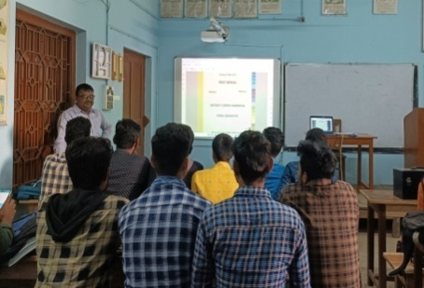
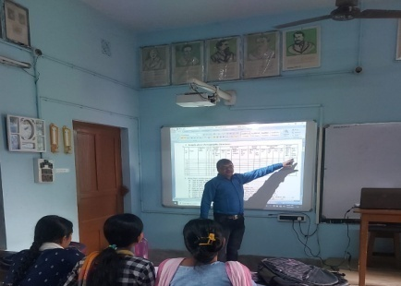
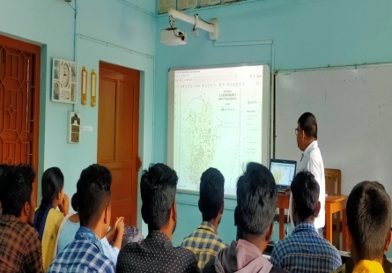
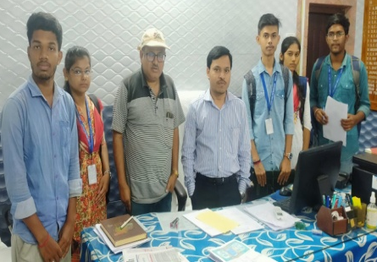
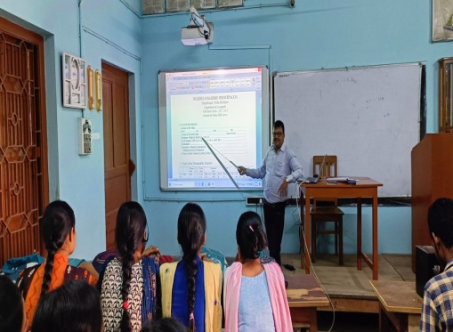
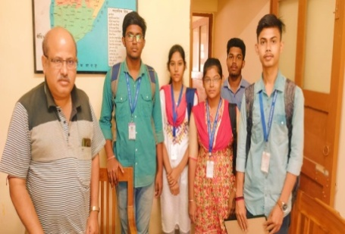
SOME MOMENT OF PRE FIELD-STAGE

Slide 9
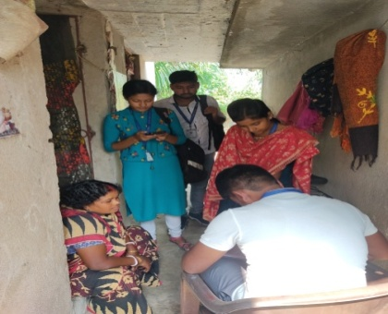
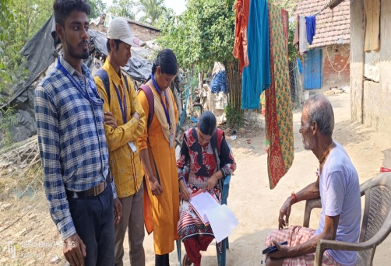
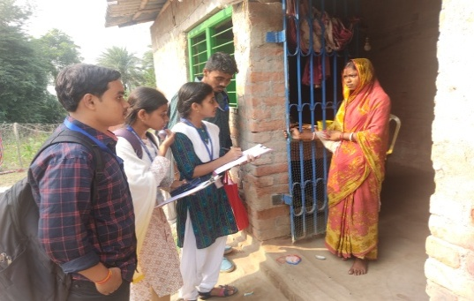
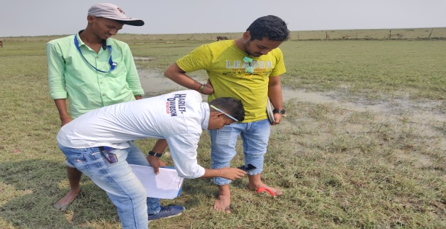
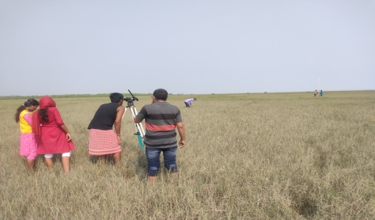
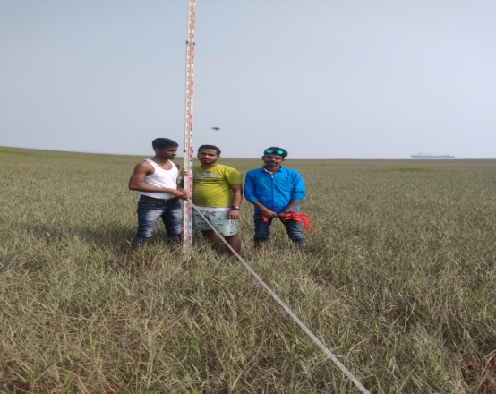
SOME MOMENT OF DURING FIELD STAGE

Slide 10
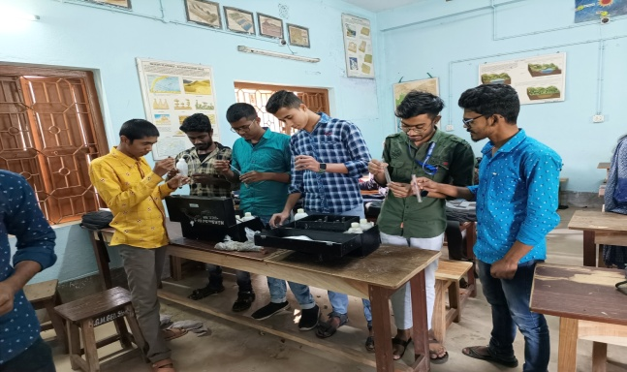
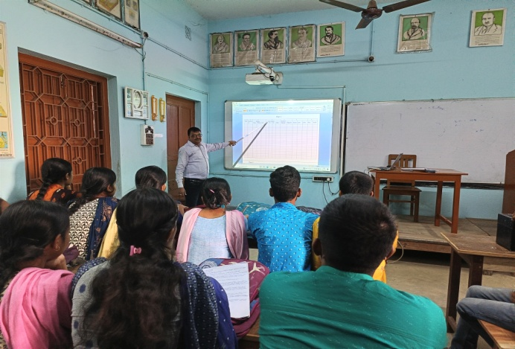
SOME MOMENT OF POST FIELD STAGE

Slide 11
SCHEME OF REPRESENTATION
For systematic representation the whole survey report has been divided into 8 chapters which is given below-
CHAPTER-1: This chapter analysis the physical set up of this study area.
CHAPTER-2: This chapter used for land-use pattern details in this village
CHAPTER-3: This chapter analysis the demographic structure of the village.
CHAPTER-4: This chapter used for details discussion of the housing condition, energy
consumption and basic amenities etc. in this village.
CHAPTER-5: This chapter used for discussion of economic set up of the village.
CHAPTER-6: This chapter discuss about the facility of accommodation.
CHAPTER-7: This chapter analysis the social structure of the study area.
CHAPTER-8: These chapter different problems faced by the people are analysis and find out
solving method.

Slide 12
LOCATION OF THE STUDY AREA:-
Name of the village | Type of location | Description
SAFARCHATA J.L NO-53 | Geographical location | Latitude | 21˚51’16”N - 21˚51’34”N
 |  | Longitude | 87˚57’57”E - 87˚58’18”E
 | Administrative location | State | West Bengal
 |  | District | Purba Medinipur
 |  | Subdivision | Contai
 |  | Block | Khejuri-II
 |  | Police Station | Khejuri
 |  | Grampanchayet | Khejuri
 |  | Post | Janka S.O
 |  | Pin | 721431
 | Relative location | North Side | Alichak- J.L No-51
 |  | South Side | Radhanagar- J.L No-54
 |  | East Side | Hooghly River
 |  | West Side | Bamanchak- J.LNo-52
 | Topo sheet No | Old series | 73O/13
A very popular name of our study area Safarchata village situated at coastal location becomes strategically important from environmental as well as socio economic point of view.

Slide 13
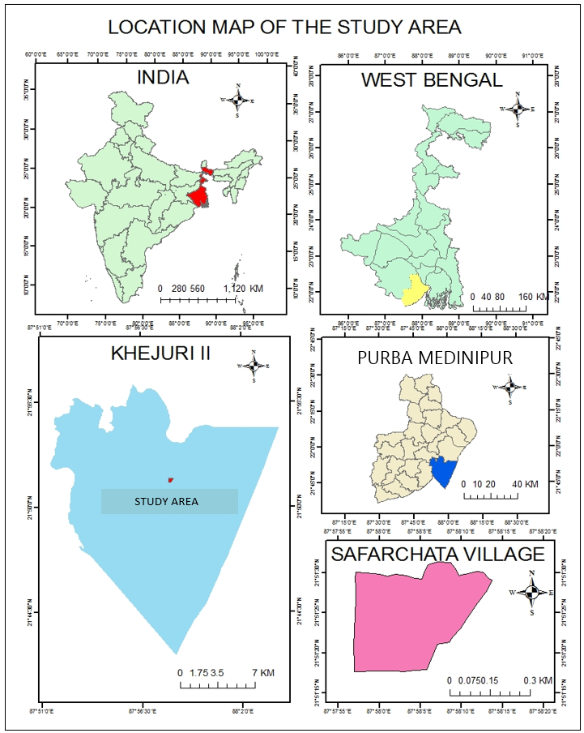

Slide 14
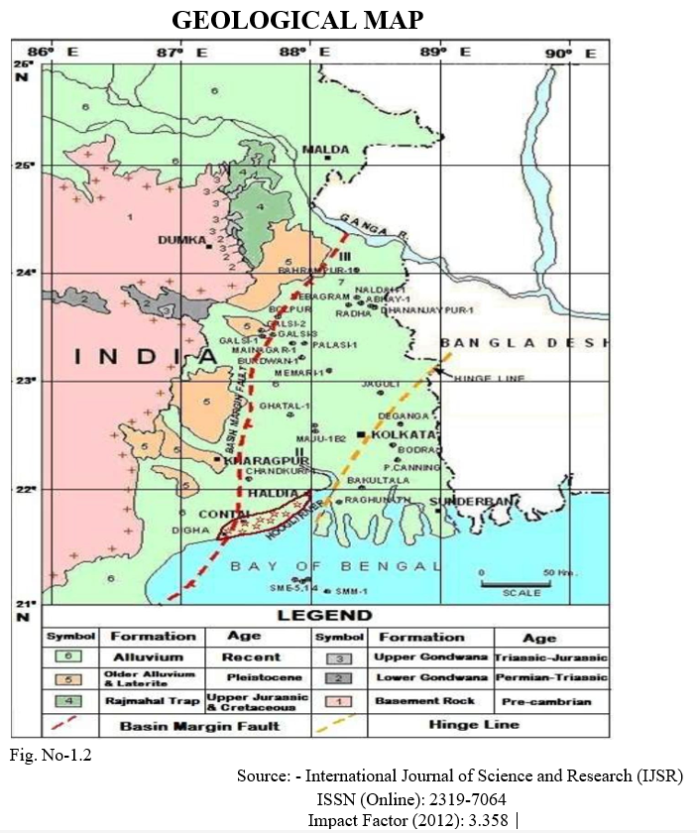
GEOLOGICAL STRUCTURE
The study area consists of alluvium formation in recent age. This area in under line by unconsolidated sediments of sand clay. Purba Medinipur district is originated with the composition six different types of geological formations during the Late Pleistocene to Late Holocene period. Above area consist beach formation in Late Holocene period. The study area is marking in showing geological map.
Period | Geological formation | Materials
Late Holocene | Beach formation | Very fine, white to grey sands mixed with clay

Slide 15
RELIEF STRUCTURE
The study area is part of the lower Indo-Genetic Plain and Eastern Coastal Plains. Topographically, the study area can be divided into two parts – (a) almost entirely flat plains on the west, east and north, (b) the coastal plains on the south. The vast expanse of land is formed of alluvium and it composed of younger and coastal alluvial. Beach Mudflat Tidal channel is the main geomorphologic features of the study area. The elevation of the study area are within 4-6 meters above mean sea level.
S.L no. | Plot no | Absolute height in m. |  | S.l. no | plot no | Absolute height in m
1 | 33 | 04 |  | 8 | 22 | 06
2 | 25 | 06 |  | 9 | 17 | 04
3 | 21 | 06 |  | 10 | 16 | 04
4 | 18 | 04 |  | 11 | 15 | 04
5 | 19 | 04 |  | 12 | 12 | 03
6 | 20 | 04 |  | 13 | 13 | 04
7 | 24 | 05 |  | 14 | 23 | 05

Slide 16
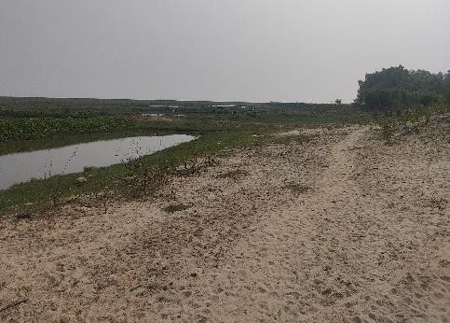
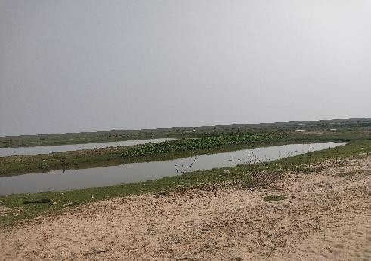
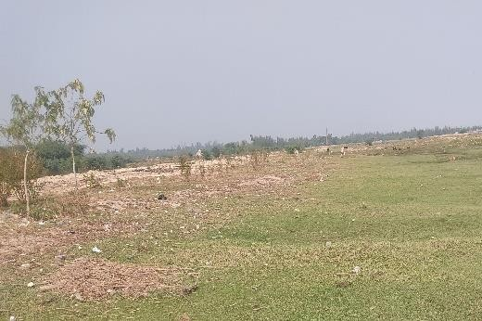
RELIEF STRUCTURE

Slide 17
  CLIMATE CONDITION
The region experiences a hot and humid monsoonal climate there are many four seasons in the study area. There are- Summer- March-May, Monsoon- June – September, autumn: - October-November Winter - December-February.
The month wise average temperature, humidity, rainy day and rainfall of the surrounding study area are given
Month | Temperature(0C) |  |  | Humidity (%) |  | Rainfall | No. of Rainy Days in a Month(Avg)
 | Max. | Min. | Mean | Max. | Min. | Avg.in mm
January | 24 | 16 | 20 | 81 | 42 | 13.00 | 3
February | 28 | 22 | 25 | 73 | 41 | 20.00 | 3
March | 32 | 26 | 29 | 84 | 45 | 30.00 | 4
April | 32 | 26 | 29 | 80 | 60 | 40.00 | 5
May | 32 | 26 | 29 | 76 | 60 | 150.00 | 10
June | 34 | 26 | 30 | 82 | 68 | 280.00 | 16
July | 34 | 26 | 30 | 85 | 61 | 280.00 | 20
August | 34 | 26 | 30 | 86 | 71 | 255.00 | 22
September | 32 | 24 | 28 | 79 | 75 | 200.00 | 17
October | 32 | 24 | 28 | 76 | 58 | 120.00 | 10
November | 29 | 26 | 27 | 76 | 55 | 50.00 | 4
December | 22 | 16 | 19 | 76 | 38 | 00.00 | 0

Slide 18
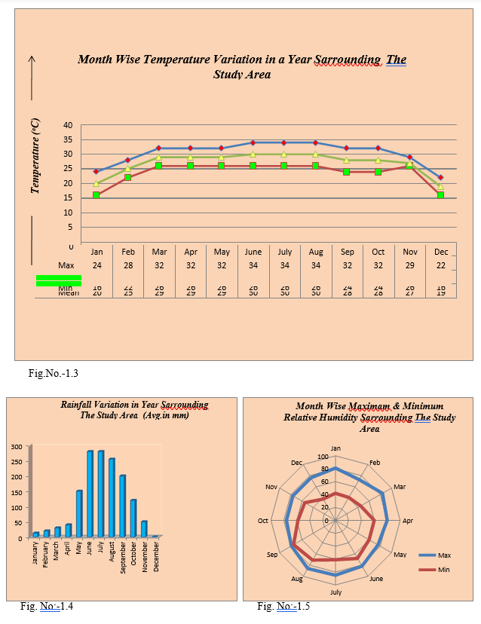

Slide 19

SOIL TYPE:-
The study area located on lower genetic plane. So mainly alluvial soil are existing on the study area. From primary survey. We say that our study area soil is
    Texture type (Sandy Clay Loam Where sand near 50% silt 20% clay30%).
    Average soil p^{H} is 7.5.That is slightly alkaline soil.

Slide 20
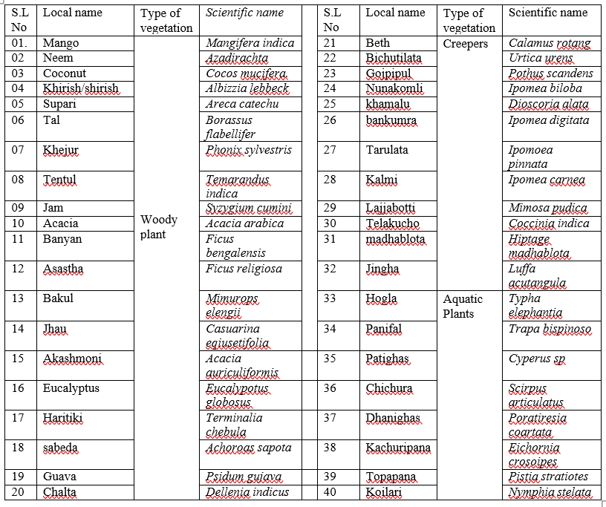
  BIOTIC COMMUNITY:-
  Biotic community is the total community of Flora and Faunal group.
  FLORAL COMMUNITY
  Mainly mesophyte type vegetation is found in along the study area. This area given below-

Slide 21
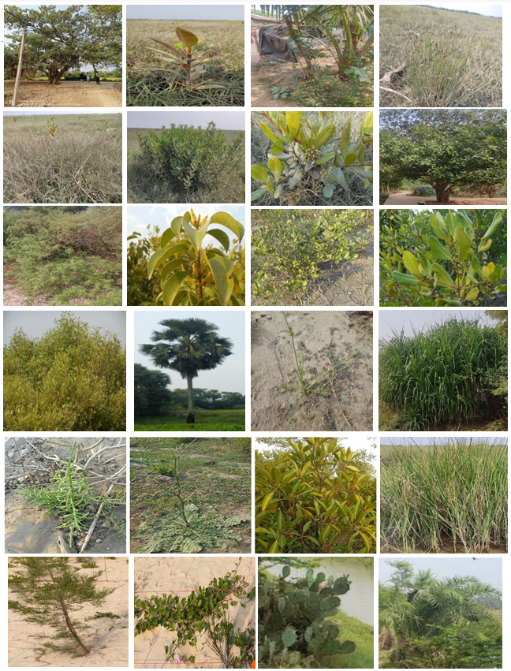
SOME PHOTOS OF FLORAL COMMUNITY

Slide 22
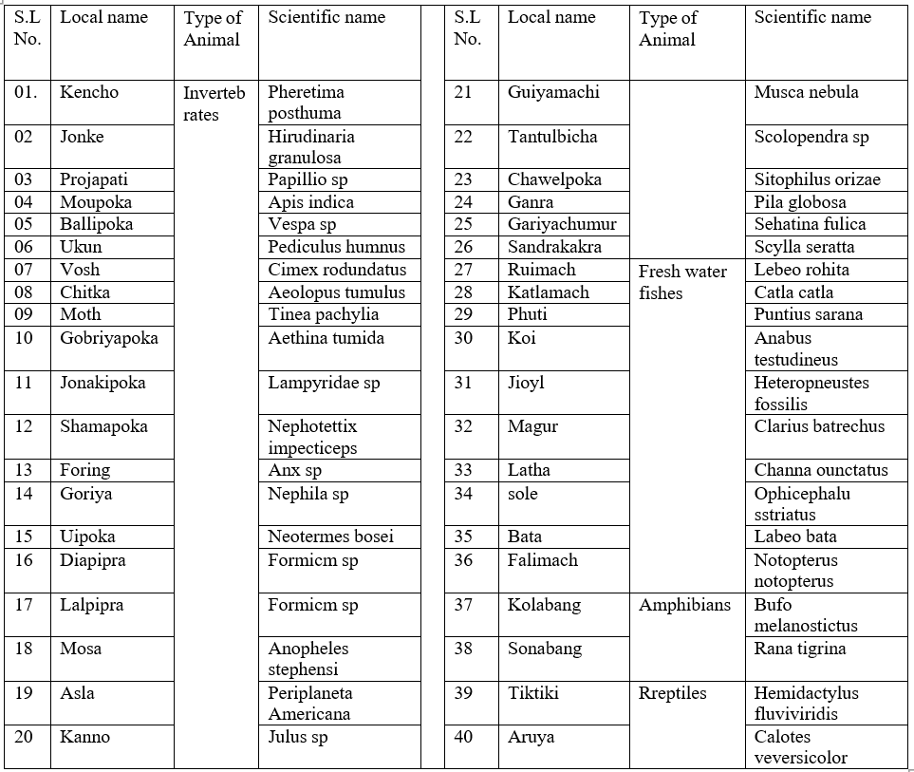
FAUNAL COMMUNITY
The area is affected by coastal process. So this type of animal are found along with study area.

Slide 23
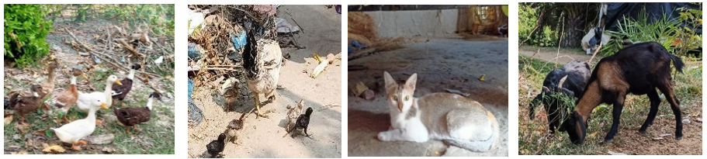
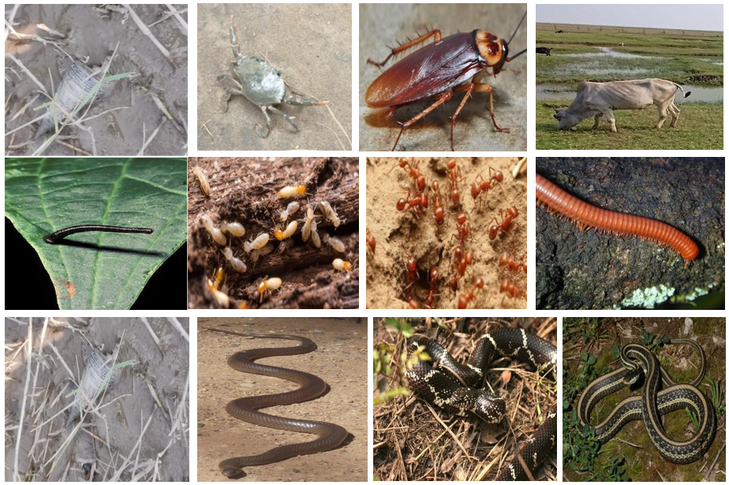
SOME PHOTOS OF FAUNAL COMMUNITY

Slide 24
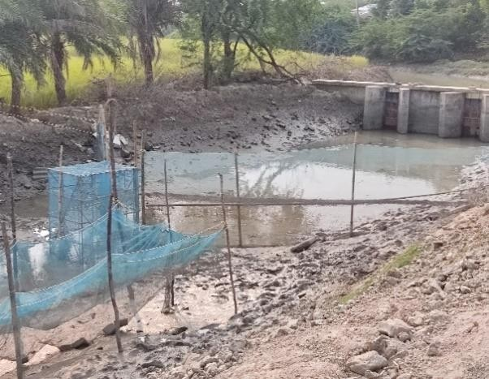
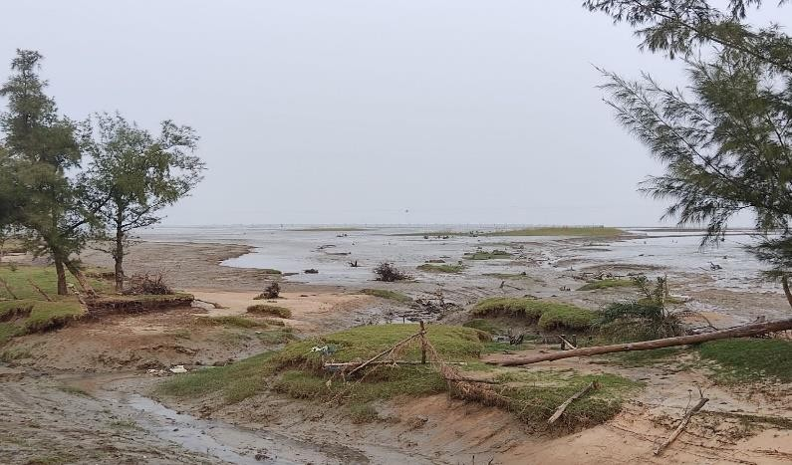
DRAINAGE SYSTEM
Hooghly River is passes along eastern side of the study area .Various type of nala of the study area are well connected with the Hooghly River.

Slide 25
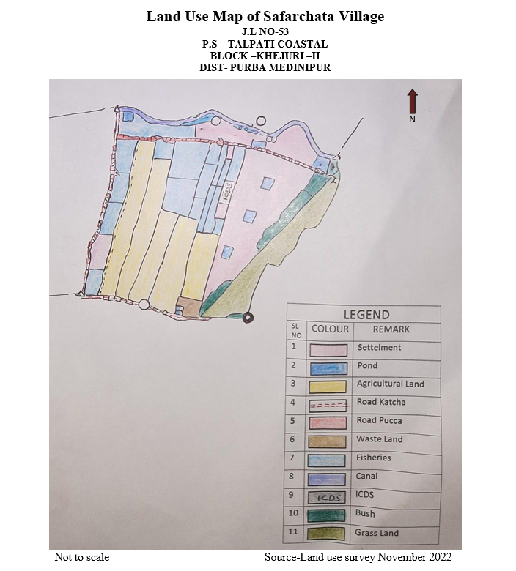

Slide 26
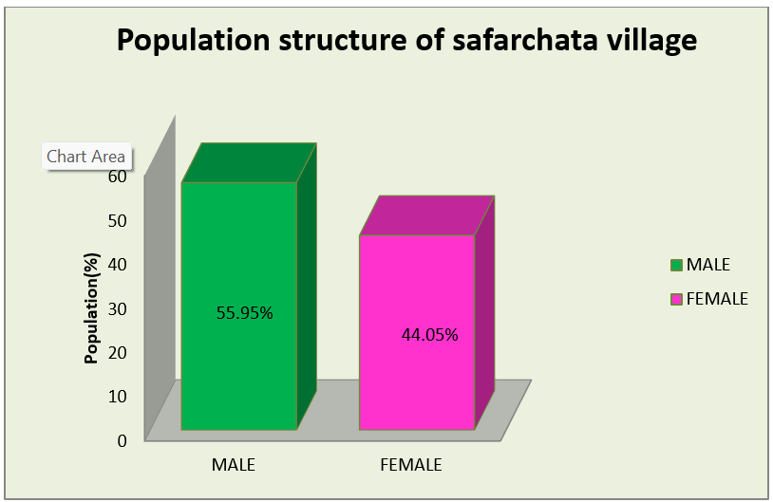
Population structure
sex | No. | Percentage%
Male | 94 | 55.95
female | 74 | 44.05

Slide 27
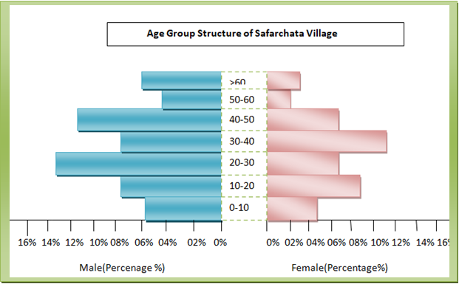
AGE SEX STRUCTURE
Age | population |  | Population (%)
 | Male | Female | Male | Female
0-10 | 10 | 08 | 05.95% | 04.76%
10-20 | 13 | 15 | 07.74% | 08.94%
20-30 | 22 | 11 | 13.10% | 06.55%
30-40 | 13 | 19 | 07.74% | 11.31%
40-50 | 19 | 13 | 11.31% | 07.74%
50-60 | 07 | 03 | 04.17% | 01.78%
60+ | 10 | 05 | 05.95% | 02.97%

Slide 28
MARITAL STATUS
Sex | Population (%) | Marital status |  | Age of marriage
 |  | Married | Unmarried | proper | under
Male | 55.95% | 32.73% | 23.21% | 26.78% | 05.95%
Female | 45.05% | 30.96.% | 13.10% | 13.10% | 17.86%

Slide 29
RESIDENTIAL STRUCTURE
SL.No. | Type of residence | Total specimen no. | Percentage (%) | Total
1 | Original | 37 | 100% | 100%
2 | migrated | 00 | 00.00%

Slide 30
FAMILY TYPE
SL.No | type of family | specimen no | Percentage (%) | Total
1 | Nuclear | 24 | 64.90% | 100%
2 | Joint | 12 | 32.40%
3 | others | 1 | 02.70%

Slide 31
RELIGION STRUCTURE
SL.no | Type of family | Specimen no | Percentage (%) | Total
1 | Hindu | 35 | 94.60% | 100%
2 | Muslim | 2 | 05.40%
3 | others | 0 | 00.00%

Slide 32
CASTE STRUCTURE
SL.no | Type of family | Specimen no | Percentage (%) | Total
1 | General | 00 | 00.00% | 100%
2 | SC | 35 | 94.6%
3 | ST | 00 | 00.00%
4 | OBC | 02 | 05.40%

Slide 33
EDUCATIONAL STRUCTURE
SL.No | Educational structure | Level | Total population | Percentage (%)
1 | Illiterate |  | 101 | 60.10%
2 | Literate | VIII | 22 | 12.50%
 |  | X | 30 | 17.91%
 |  | XII | 16 | 09.50%
 |  | B.A\B.Sc. | 00 | 00.00%
 |  | M.A\M.SC. | 00 | 00.00%
TOTAL |  |  | 168 | 100%

Slide 34
HEALTH STATUS
SL.No | Height (ft) | No of person | Percentage (%) | Total
1 | <2.5 | 04 | 02.38% | 100%
2 | 2.5-3.5 | 06 | 03.57%
3 | 3.5-4.5 | 24 | 14.29%
4 | 4.5-5.5 | 97 | 57.74%
5 | >5.5 | 37 | 22.02%

Slide 35
HEALTH STATUS
SL.no | Weight(kg) | No of person | Percentage (%) | Total
1 | <30 | 20 | 11.90% | 100%
2 | 30-40 | 14 | 8.33%
3 | 40-50 | 48 | 28.57%
4 | 50-60 | 62 | 36.21%
5 | >60 | 24 | 14.29%

Slide 36
TYPE OF HOUSE
S.l. no | Type of house | Spaceman No | Percentage (%)
1 | Katcha | 14 | 37.80%
2 | pucca | 04 | 10.80%
3 | Semi pucca | 19 | 51.40%

Slide 37
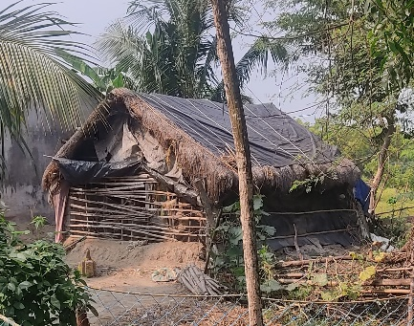
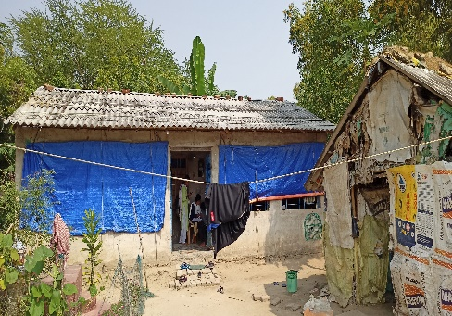
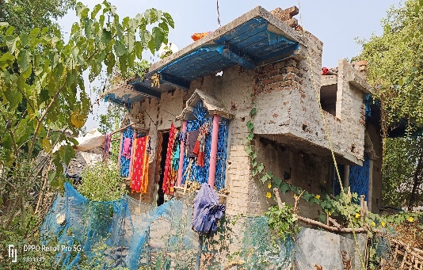
DIFFERENT TYPE OF HOUSE OF SAFARCHATA VILLAGE

Slide 38
TYPE OF WALL
S.l. No | Type of wall | Spaceman No | Percentage (%)
1 | Katcha | 17 | 45.90%
2 | Pucca | 20 | 54.10%

Slide 39
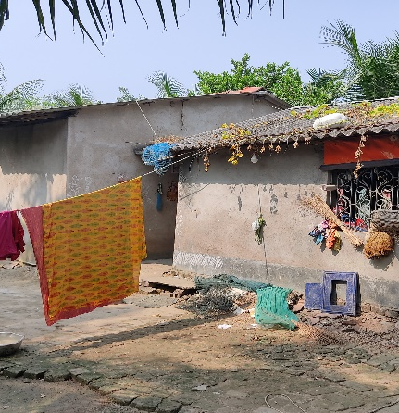
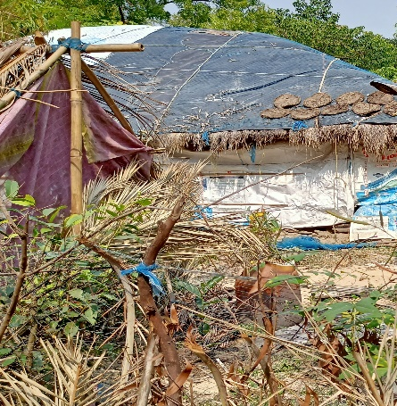
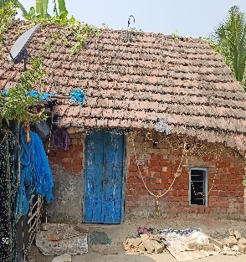
ROOF STRUCTURE OF HOUSES IN SAFARCHATA VILLAGE

Slide 40
BUILT UP AREA
S.L. No | Type of built-up area(sq ft) | Specimen no | percentage
1 | <250 | 13 | 35.20%
2 | 250-500 | 17 | 49.90%
3 | 500-750 | 07 | 18.90%
4 | >750 | 00 | 00.00%

Slide 41
NUMBER OF ROOM
S.l. no | Number of room | Specimen no | percentage
1 | One | 10 | 27.00%
2 | Two | 21 | 56.80%
3 | Three | 05 | 13.50%
4 | Four | 01 | 02.70%
5 | More than four | 00 | 00.00%

Slide 42
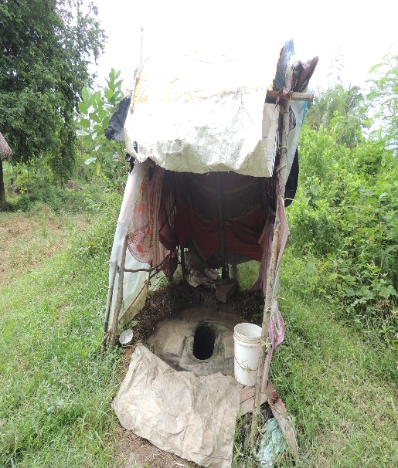
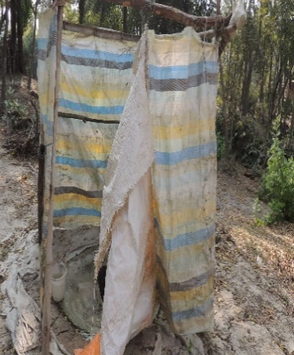
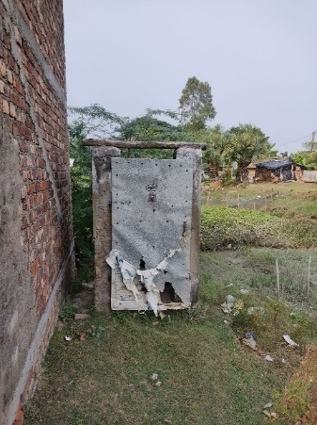
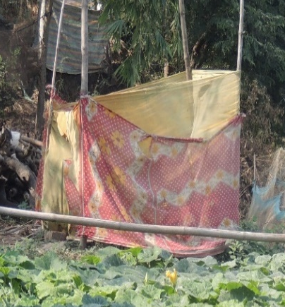
SYSTEM OF LAVATORY IN SAFARCHATA VILLAGE

Slide 43
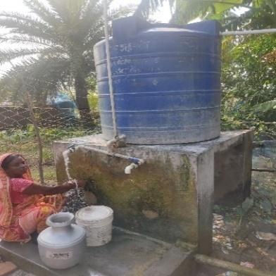
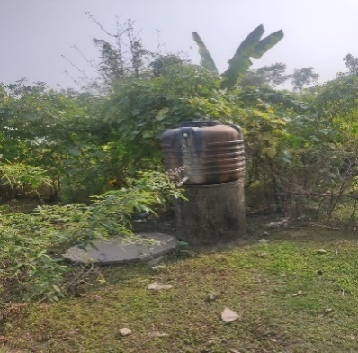
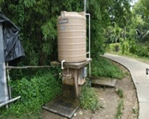
SOURCE OF DRINKING WATER OF SAFARCHATA VILLAGE

Slide 44
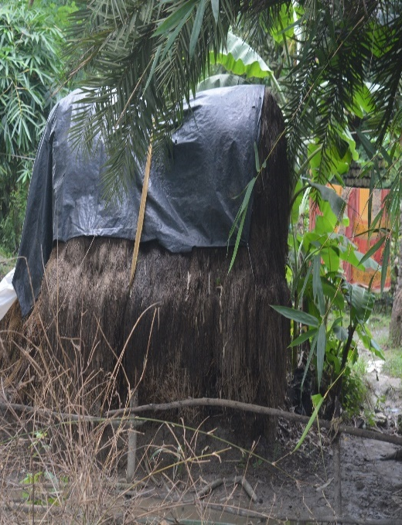
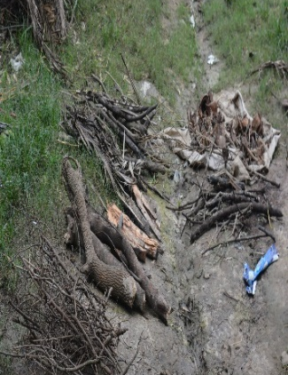
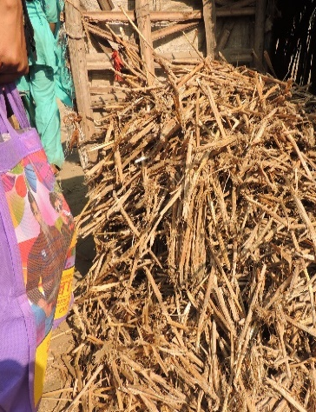
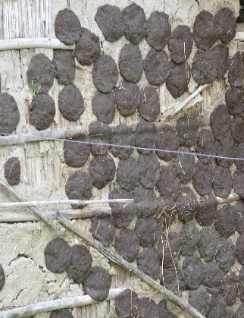
SOURCE OF ENERAGY CONSUMPTION IN SAFARCHATA VILLAGE

Slide 45
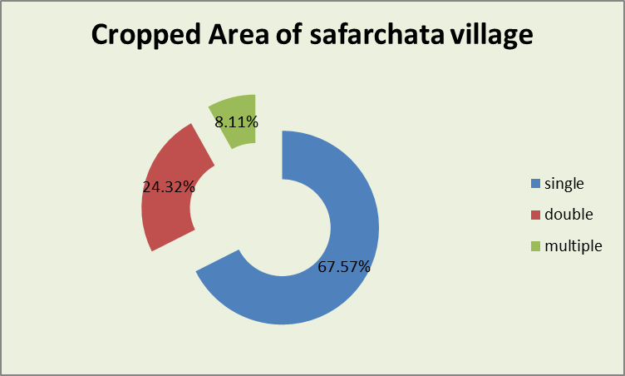


AGRICULTURAL CONDITION

Slide 46

AGRICULTURAL CONDITION

Slide 47
OCCUPATIONAL STRUCTURE
Non workers |  | workers
 |  | Primary workers |  | Secondary workers |  | Tertiary workers |  | Other workers.
NO | % | NO | % | NO | % | NO | % | NO | %
106 | 63.09 | 52 | 30.95 | 07 | 04.17 | 03 | 1.79 | 00 | 00.00

Slide 48






DIFFERENT OCCUPATIONAL STRUCTURE OF THE STUDY AREA

Slide 49


INCOME STRUCTURE

Slide 50




HEALTH CENTER

Slide 51




EDUCATIONAL CENTER:

Slide 52




ADMINISTRATIVE OFFICE

Slide 53
RATION CARD FACILITY
Ration card |  |  | Total | Percentage
Old system | Yes | A.P.L | 14 | 37.84%
 |  | B.P.L | 23 | 62.16%
 | No |  | 00 | 00.00%
New system | State Govt. | PHH | 06 | 16.21%
 |  | SPHH | 11 | 29.75%
 | Central Govt. | AAY | 12 | 32.43%
 |  | RKSY-1 | 05 | 13.51%
 |  | RKSY-2 | 03 | 08.10%
 | No | No | 00 | 00.00%

Slide 54


BANKING SYSTEM AND LOAN FACILITY

Slide 55

RECRETINAL FACILITIES

Slide 56

MAJOR PROBLEMS OF THE STUDY AREA
S.l. No | Types Of Problems | No Of Response ( Family) | Percentage
Environment Problem | Soil Salinity | 11 | 29.73%
 | Coastal Flood | 33 | 89.19%
 | River Bank Erosion | 02 | 05.40%
 | Tropical Cyclone | 37 | 100.00%
Economic Problem | Poverty | 27 | 72.97%
 | Very Poor Monthly Income | 18 | 48.46%
 | Very Poor Per Capital Income | 20 | 54.05%
Social Problem | Lack Of Proper Shelter | 28 | 75.67%
 | Illiteracy | 19 | 51.35%
 | Superstition | 23 | 62.16%
Political Problem | Political Violence | 01 | 10.81%

Slide 57



MAJOR PROBLEM OF THE STUDY

Slide 58
SUMMARY
In course of the survey work, we have been fruitful and known the new environmental and social variations about the region.
During the survey we see physical characteristics (Relief, Rive, and Vegetation) of the village and cultural activities (House, Toilets, Culture, Service, economic condition, health education, and working facility) of the village dwellers.
We realize how to make communication system growth and explore knowledge by collage community relation. We are now conscious of other society because we have to collect some experiences by entire field work.
Now we fulfill a survey report and we also procure knowledge about the socio economic and physical condition of the study area. Our aim & objectives have been fulfilled to know the sub coastal region how to affect the human brings. Thanks to God, we are able to do this work very sincerely. Our interest is increased during their field work; we want to collect more knowledge in future about the coastal region.
We see that some problems attack to development. But some prospects encourage the people how to persist with nature.
For better development the drastic steps should be undertaken by the state and central govt. as early as possible. For this purpose release funds should be formed at Safarchata village for the first development in terms of economy and population automatically

Slide 59
CONCLUSION
S
Every study brings out an analytical scenario of a particular region. After thorough analysis of physical environment mainly physiographic, Geology, climate, drainage. Soil and vegetation, it is clear that the nature of our survey area is basically coastal one. Which is includes a perfect coastal region. We see that some problems attack to development. But some prospects encourage the people how to persist with nature. For better development the drastic steps should be undertaken by the state and central govt. as early as possible. For this purpose release funds should be formed at Safarchata village for the first development in terms of economy and population automatically.

Slide 60
SUGGESTION AND SOLVATION METHOD
In case of our study area there may be suggested different management strategies for reduced by rising problem
This strategies are given below-
To control soil erosion for favorable environment of agriculture.
Take some strategies for controlled of flood.
Take some step for decrease of soil salinity to improve agricultural condition.
To improve bad condition of road for better transport & communication.
To improve sanitation system for better health environment.
To increase female literacy rate.
To increase monthly and per capita income of every family.

Slide 61

Thank you
Create By Indranil
Dept. of Geography
Mugberia Gangadhar Mahavidyalaya

